Slide 1

Meet the Teacher…
Welcome to Year 1

Slide 2


Slide 3


Slide 4
School Behaviour policy
Expectations:
Sanctions:
Your first point of call would be to email or speak to the class teacher. Please do not use personal emails or phone numbers if it is a school related issue.
If you are dissatisfied with teacher response, you can then arrange an appointment with the Head teacher.

Slide 5
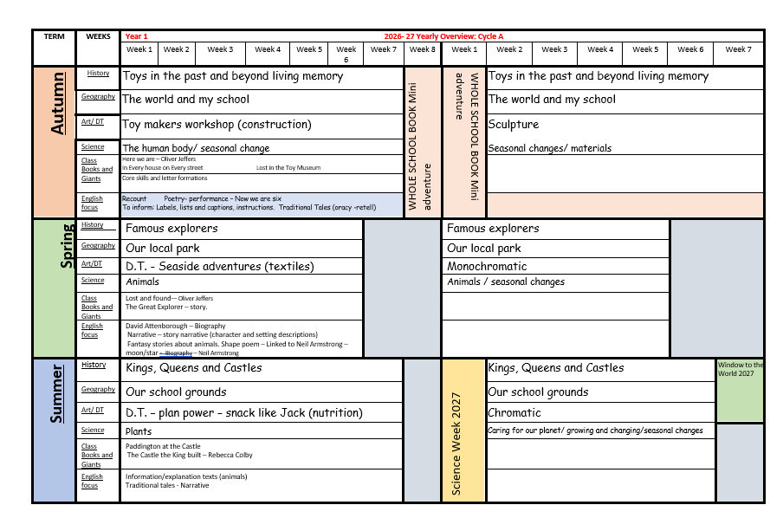
Year 1 Yearly Overview

Slide 6

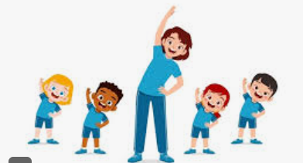
PE
PE
Thursday/Friday
Earrings out or taped.
Any other items of jewellery removed.
Children need to come to school wearing their PE kit.

Slide 7
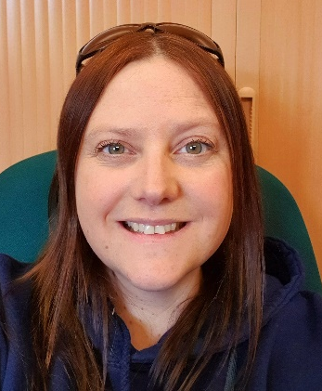
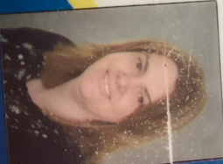
Adults in Year 1
Mrs Dale
Miss Russell
Monday - Thursday
Thursday afternoon
Friday

Slide 8


Reading in school and at home
School
The children read daily as part of our synthetic phonics lessons – sounding and blending using grapheme phoneme correspondence.
Read and change book in school once a week.
Children will read a range of genres. (e.g. letters, stories, poetry and facts)
Regularly assessed using ELS phonic assessment to pitch reading books.
At Home
Read 3/5 times a week.
Sign reading diary each time reading is done.
This should include talking about the story, identifying repeated words, asking when they’re not sure of the meaning of a word, predicting … reading is so much more than just decoding the text.

Slide 9
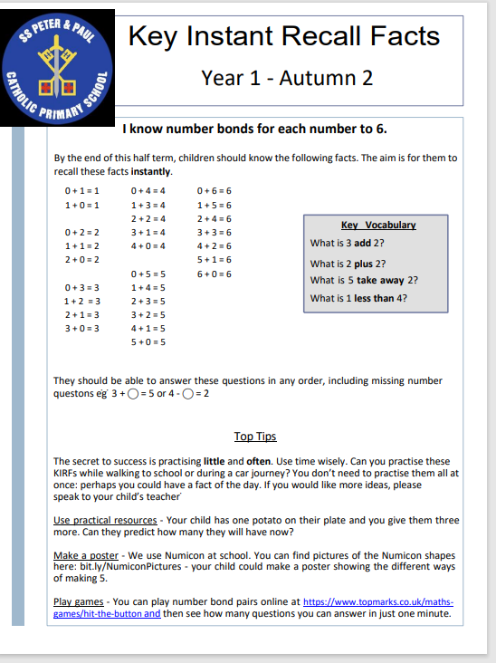
Homework
Maths – KIRFS – will be sent out each half term.

Slide 10
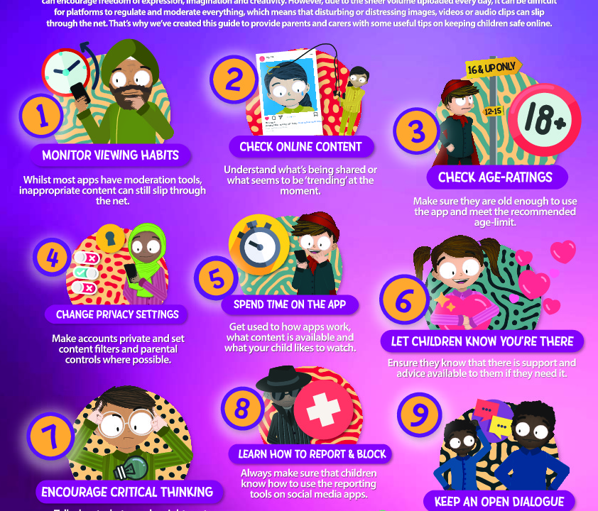

E-safety, online usage and devices
Roblox
Minecraft
Be aware of what your children are watching and accessing.
Internet safety day.
Use: https://www.nspcc.org.uk/keeping-children-safe/online-safety/
https://www.getsafeonline.org/personal/article-category/safeguarding-children/

Slide 11
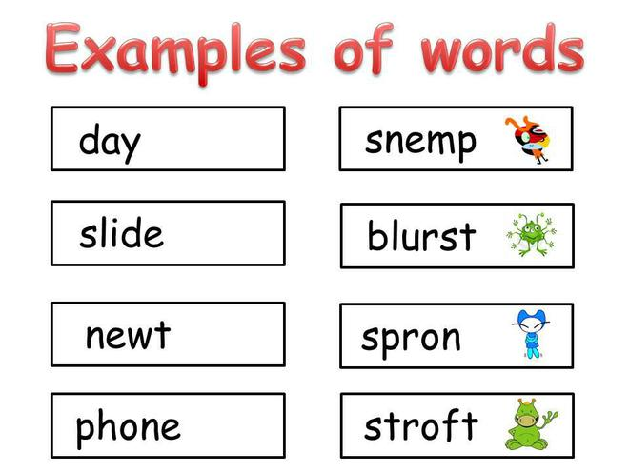
Assessment – formative and summative
Assessment in class:
Live marking/feedback
Reading assessments
Phonics
Spelling
end of term assessments
Teacher assessment is ongoing
Phonic Screening
In June the children will take the phonic screening test, a government test which assesses their ability to sound and blend real and pseudo words.

Slide 12
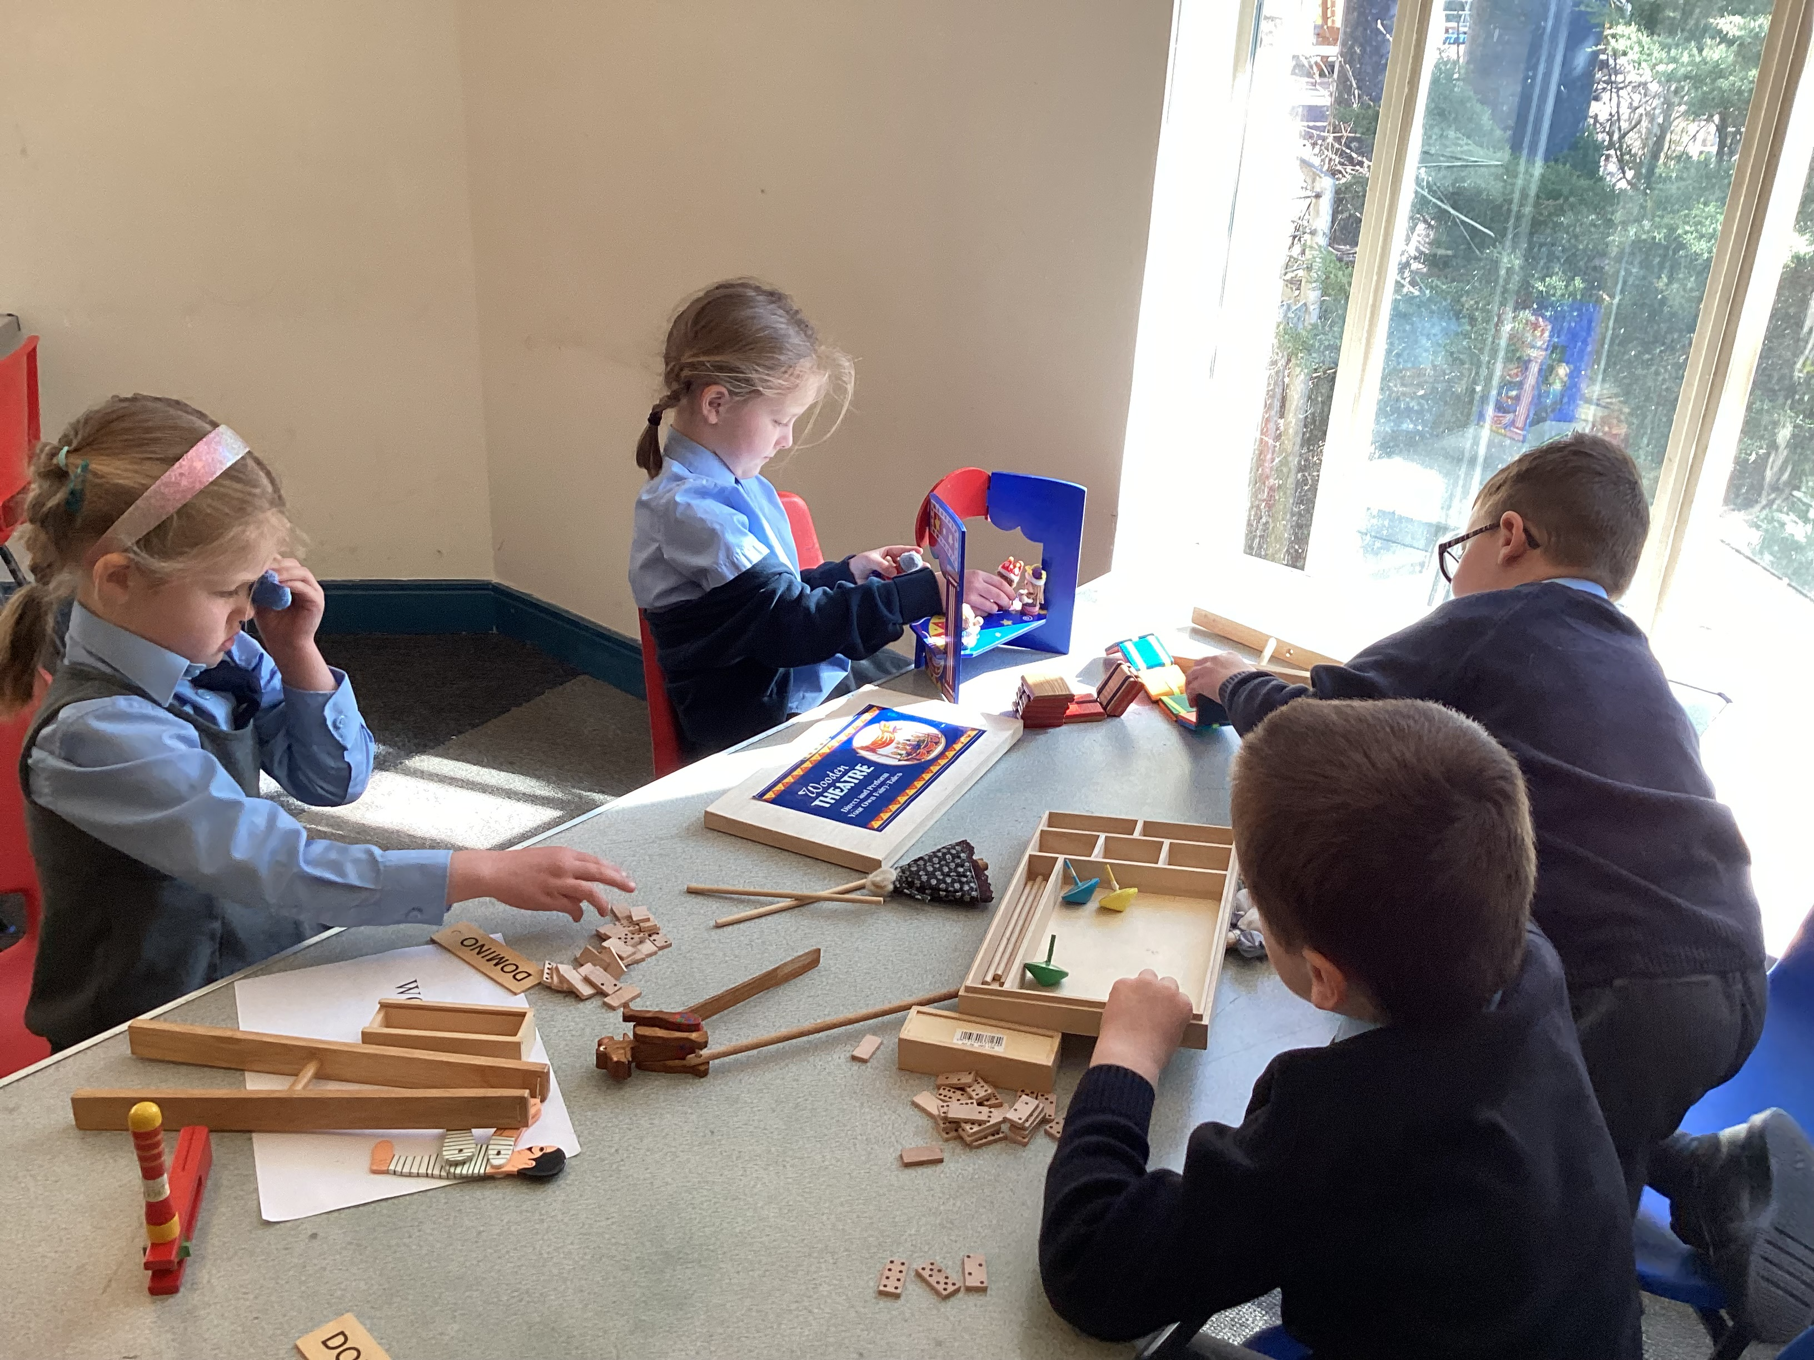
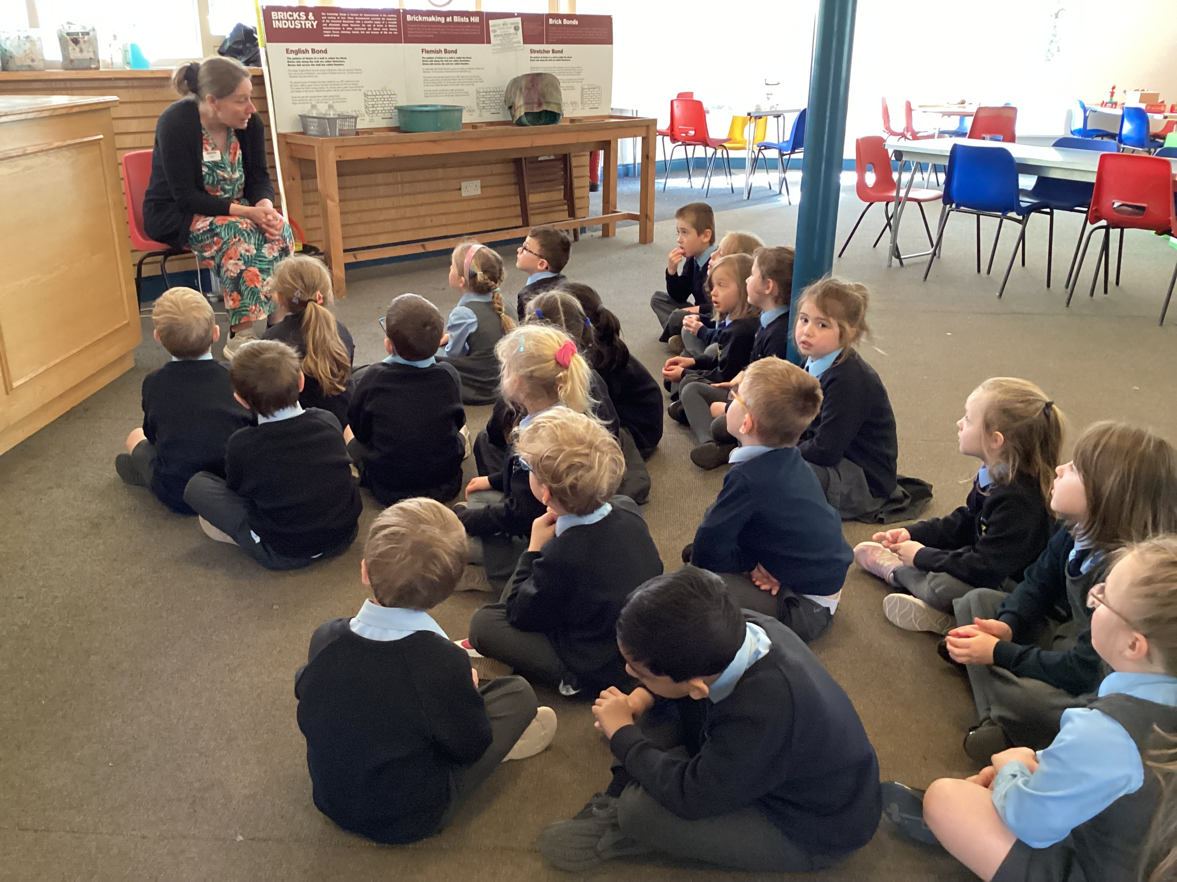
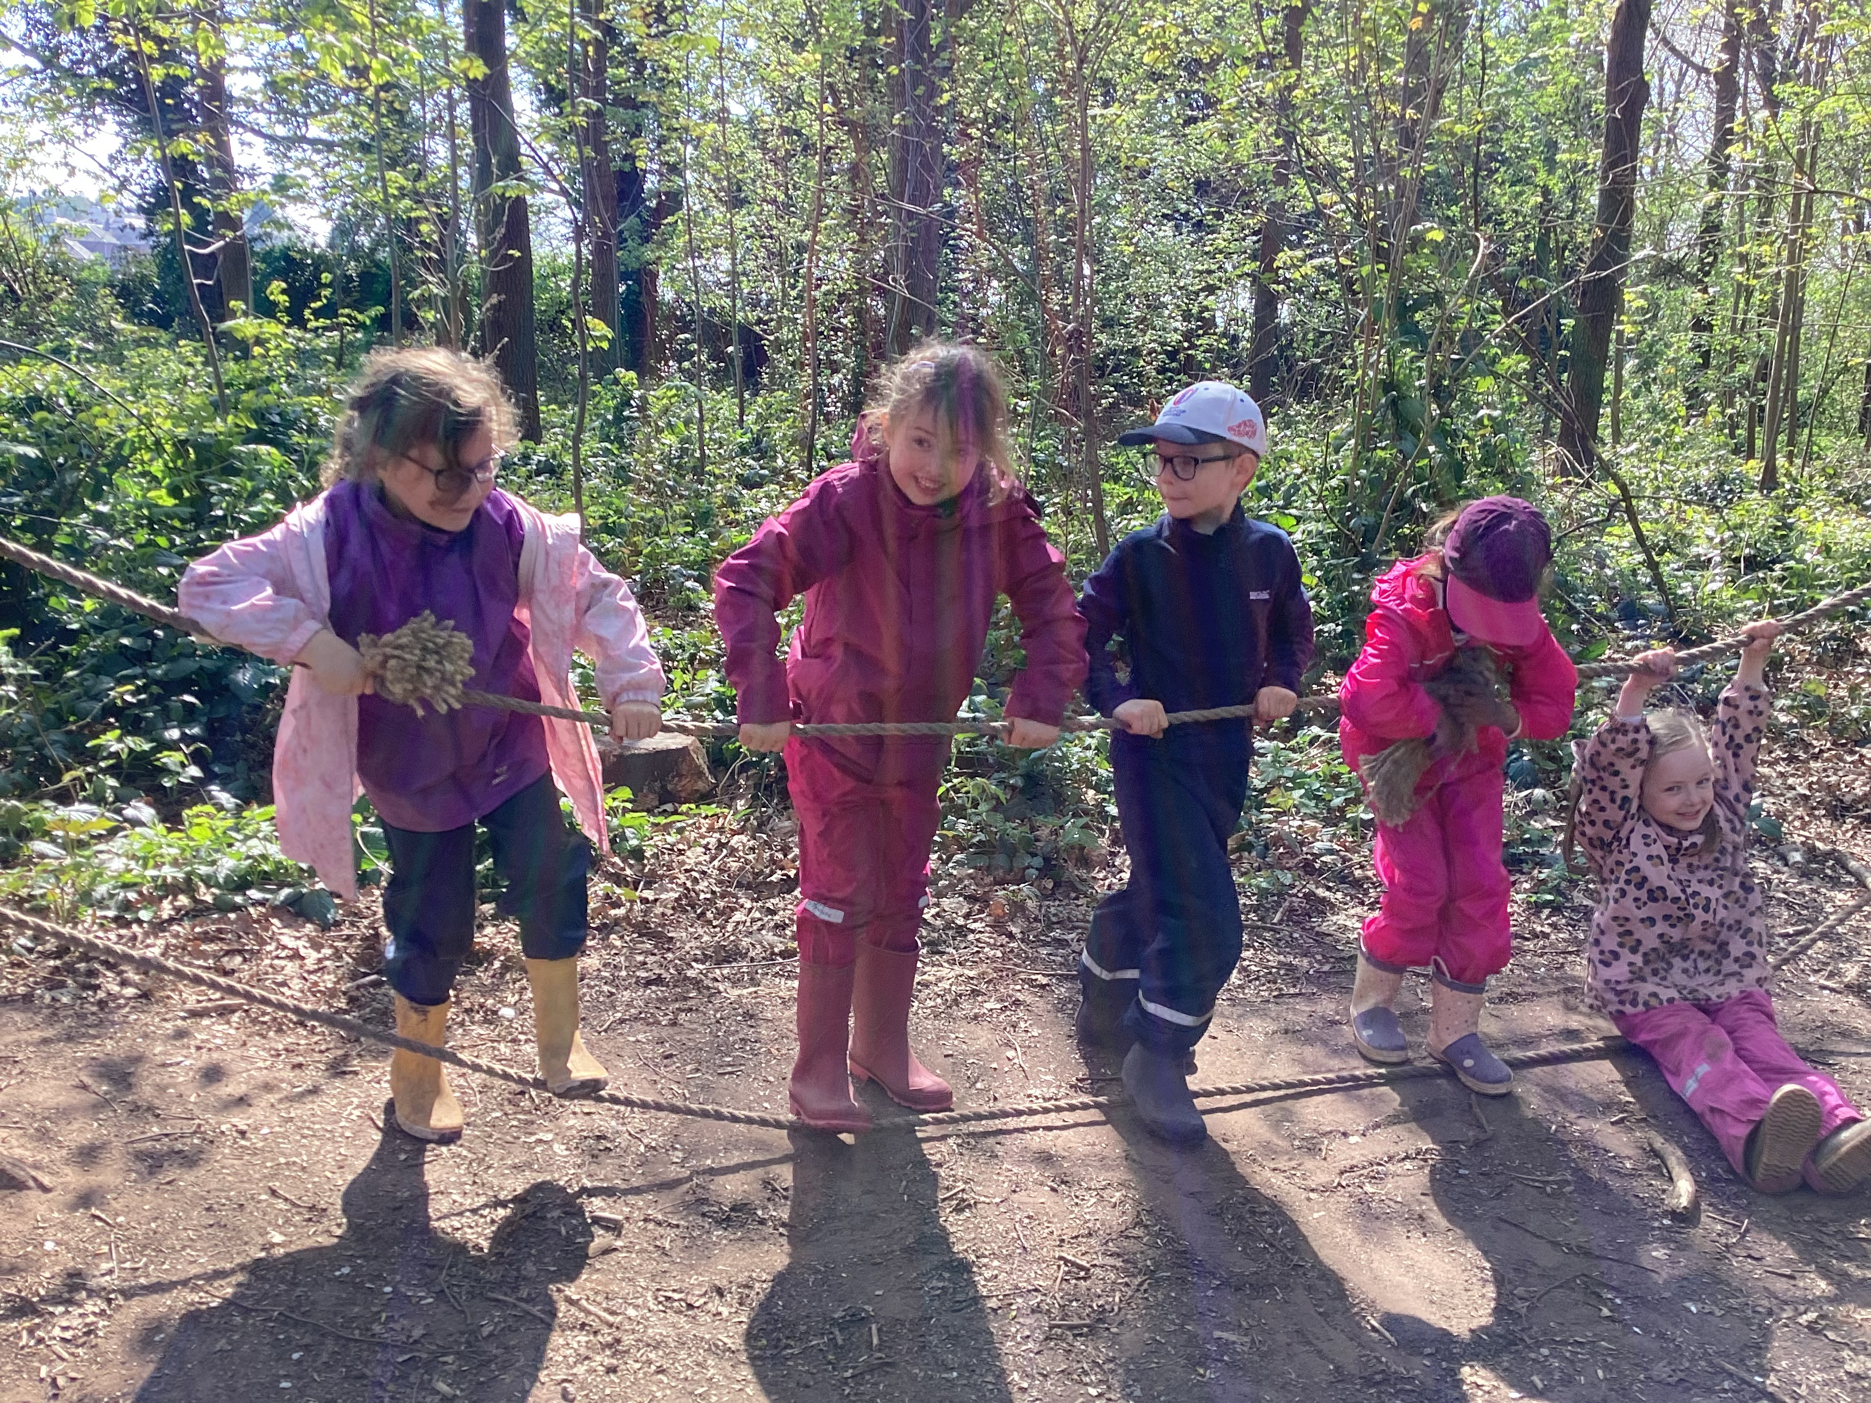
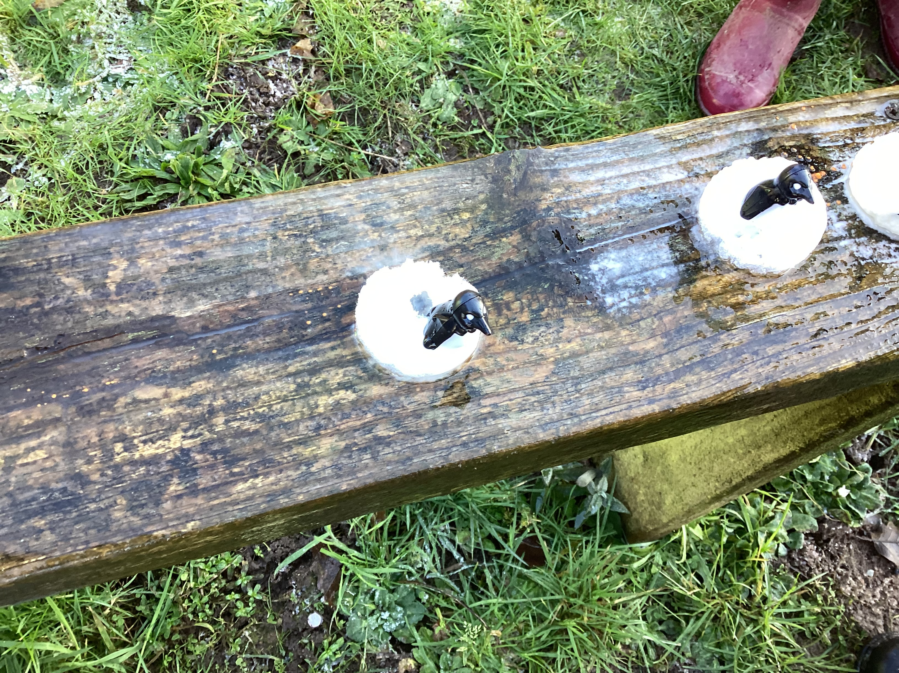
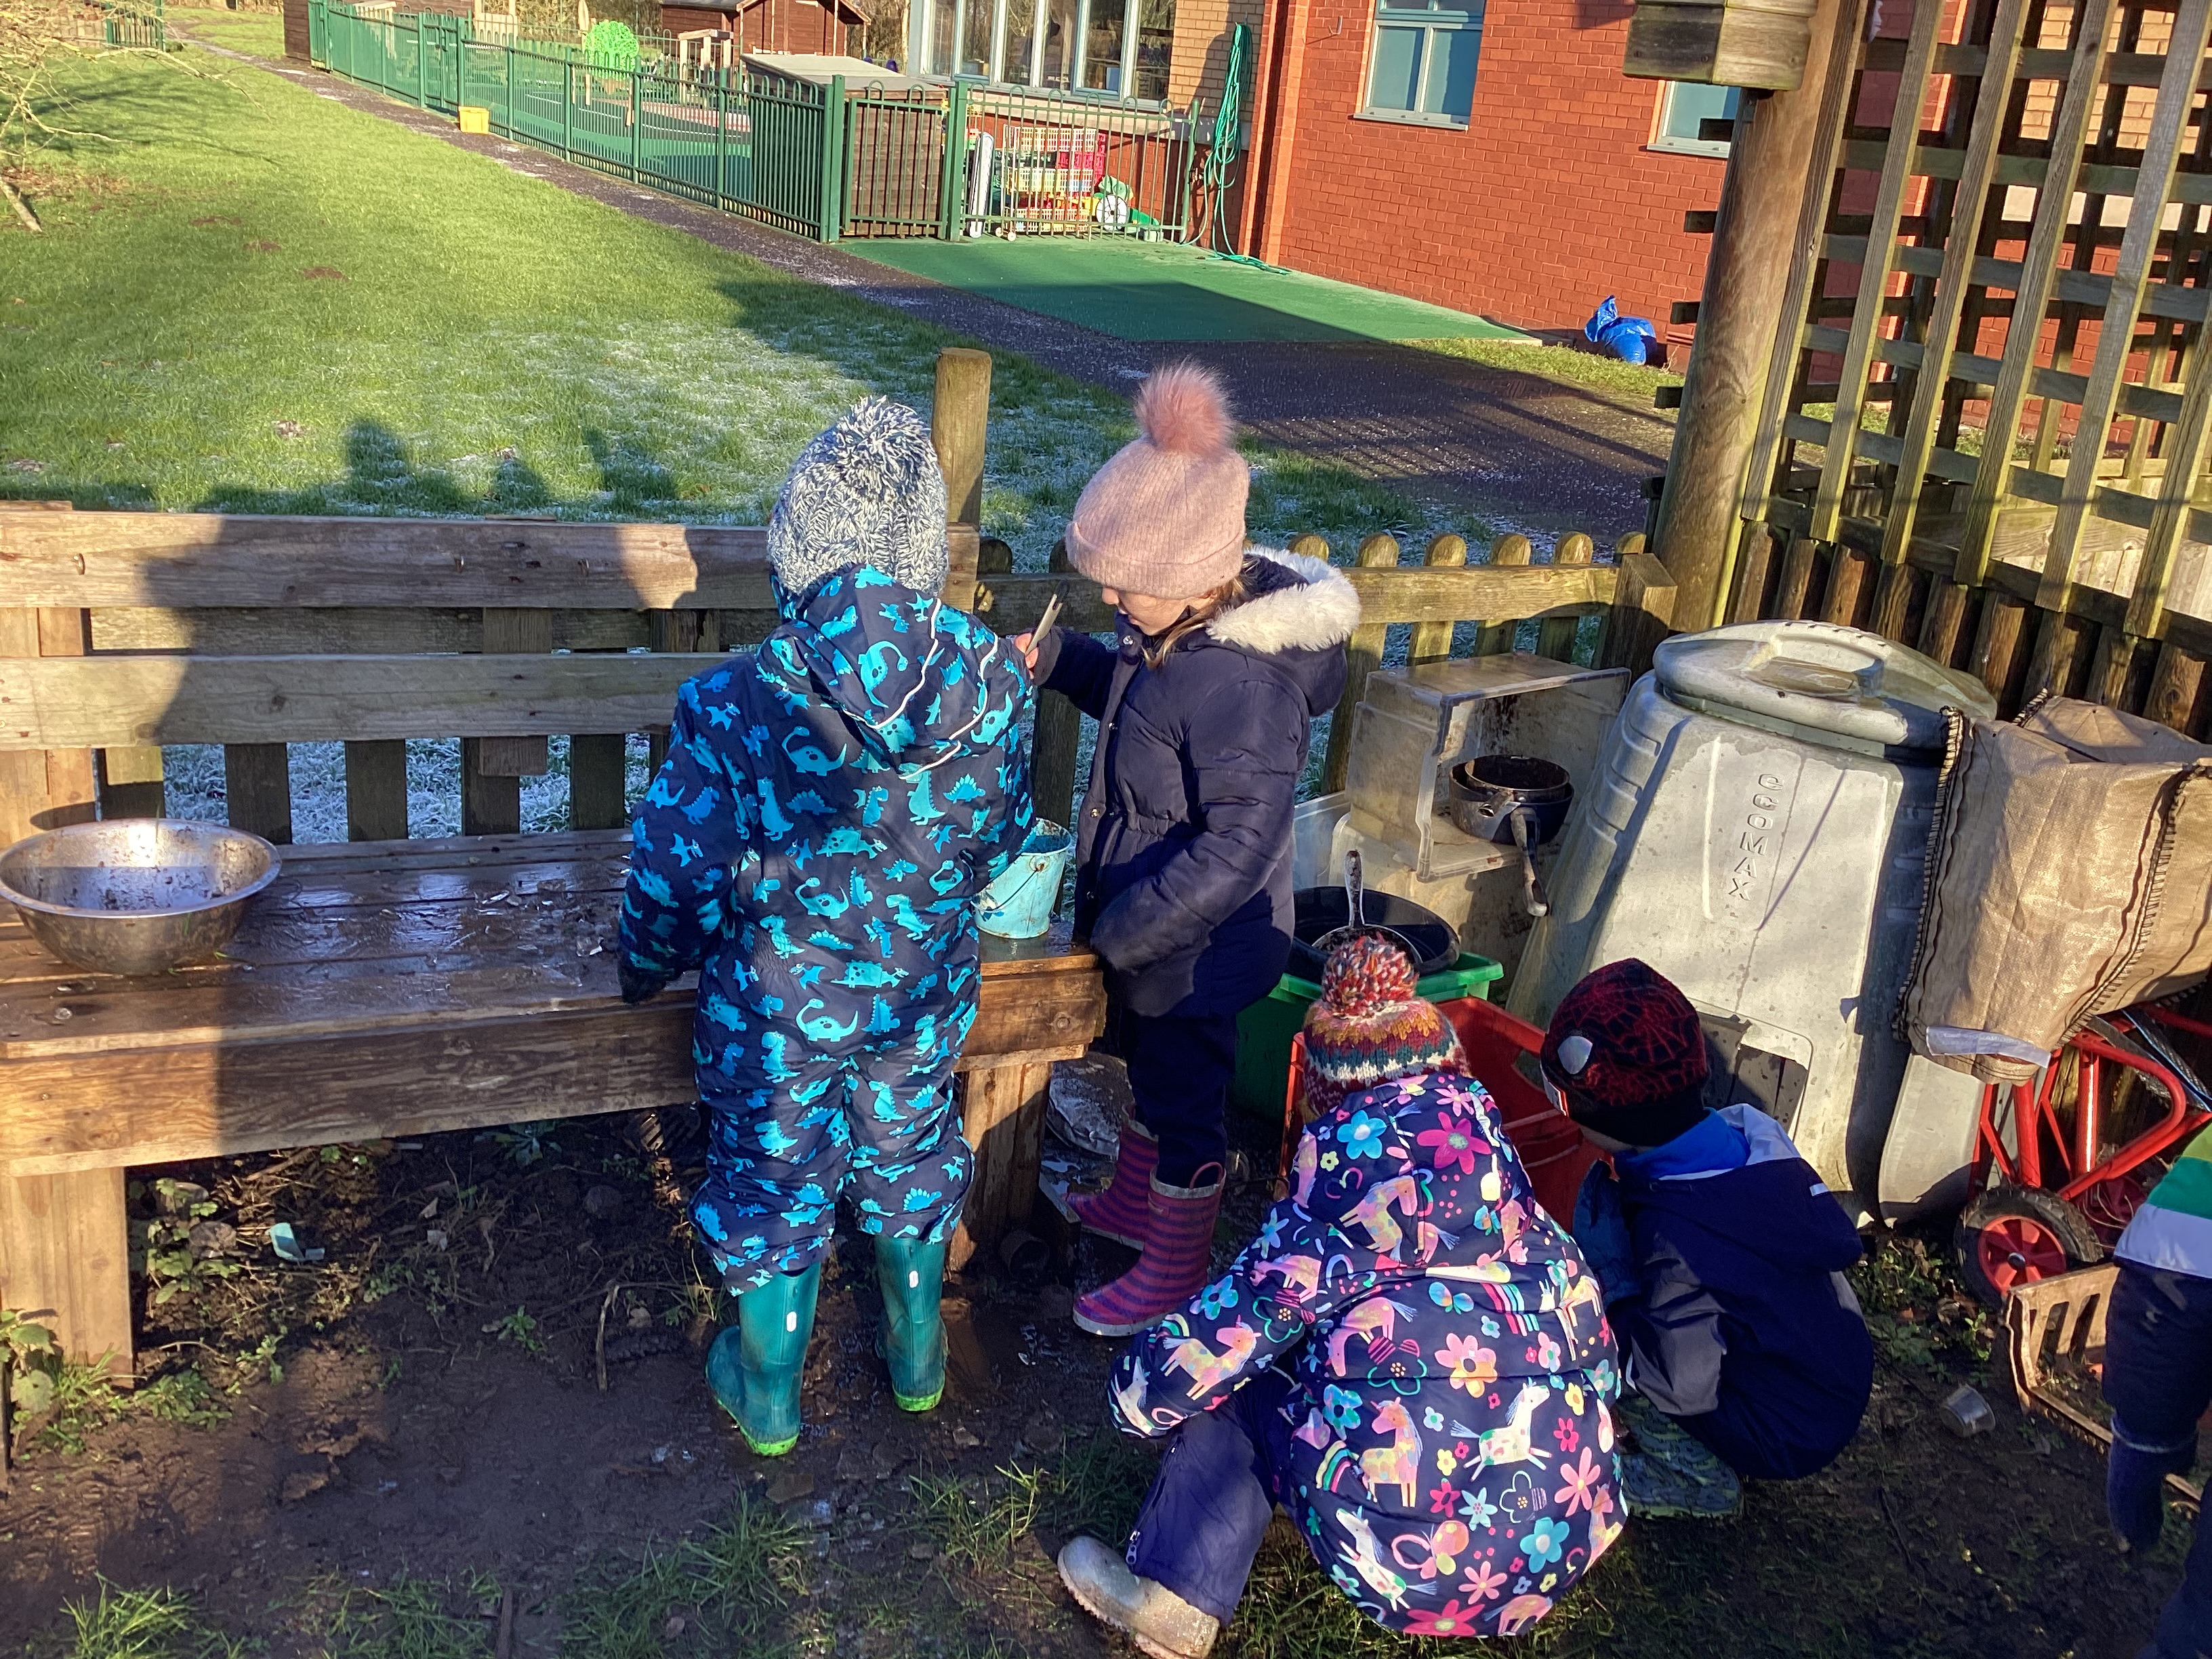
Suggested Trips for this year…
EYFS/KS1 Panto
Visit to the Church

Slide 13
Sharing books are changed every Tuesday morning.

